Slide 1
Collaborative Reinforcement Learning for Cyber Defense
Analysis of Environments, Strategies, and Policies
Author: Davide Rigoni
TNO Supervisors: Frank Fransen & Puck De Haan

Slide 2
Presentation Contents
Introduction & Background
Research Question 1 – Methodology & Results
Research Question 2 – Methodology & Results
Research Question 3 – Methodology & Results
Conclusion

Slide 3
Introduction & background

Slide 4



What is reinforcement learning?
This Photo by Unknown Author is licensed under CC BY-NC

Slide 5
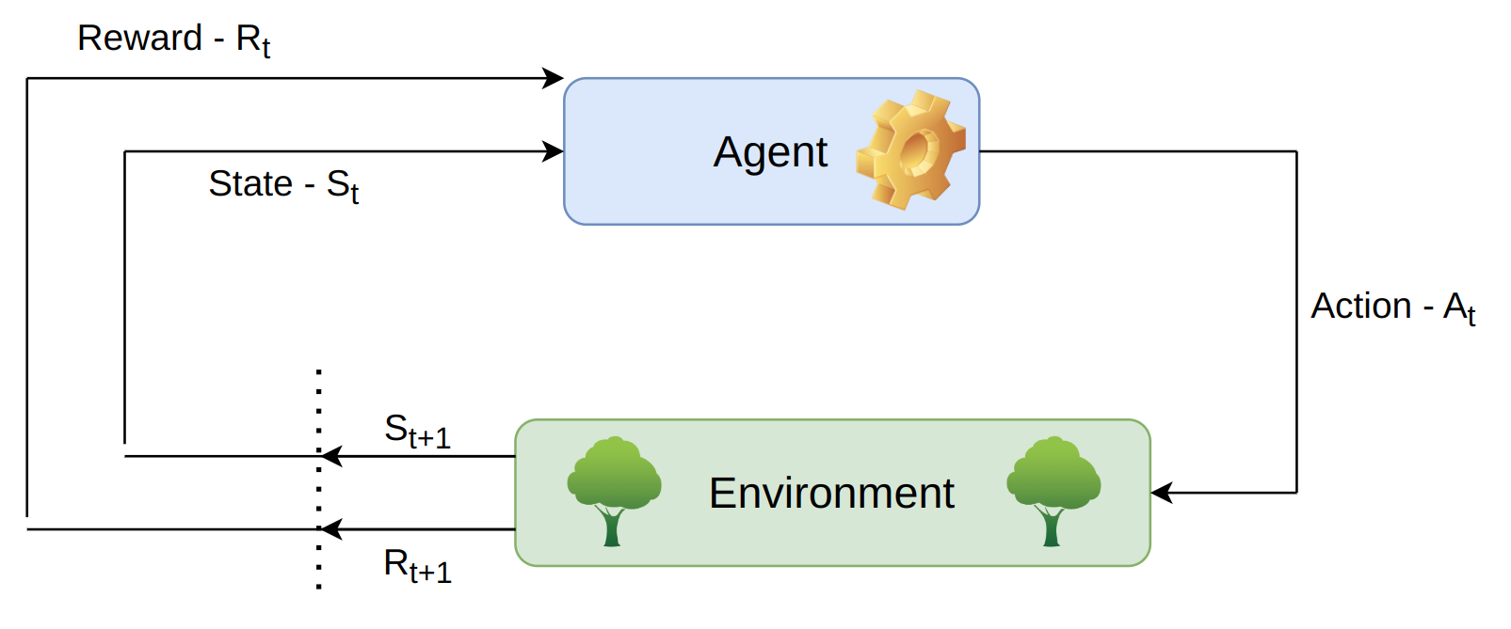
What is reinforcement learning?
This Photo by Unknown Author is licensed under CC BY-NC

Slide 6
What is reinforcement learning?
This Photo by Unknown Author is licensed under CC BY-NC

Slide 7
Important concepts in rl
Policy: The policy defines a mapping from states to actions, guiding the agent on how to act at each step

Slide 8
Important concepts in rl
Policy: The policy defines a mapping from states to actions, guiding the agent on how to act at each step
Value Function: This function estimates the expected future rewards

Slide 9
Important concepts in rl
Policy: The policy defines a mapping from states to actions, guiding the agent on how to act at each step
Value Function: This function estimates the expected future rewards
Model: The model provides a formalized description of the environment

Slide 10
Markov Decision process (MDP)
S is a finite set of states
A is a finite set of actions
P is a state transition probability matrix
R is the reward function
γ is the discount faction, γ ∈ [0, 1]

Slide 11
Partially observable mdp (poMDP)
<S, A, P, R, γ>
O, a finite set of observations
Z, an observation function that relates observations to hidden state

Slide 12
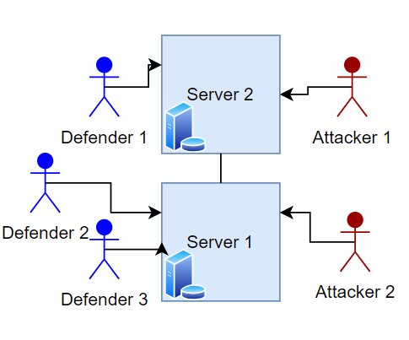
Multi-agent reinforcement learning (MARL)
Competitive – Cooperative - Mixed

Slide 13
Multi-agent reinforcement learning (MARL)
Challenges:
Non-stationarity
Action-Reward Attribution
Scalability
Policy Optimality

Slide 14
Dec - poMDP
<S, A*, P, R, γ, O*, Z>
N : the set of all agents
A* and O* : joint action/observation sets

Slide 15
Research Questions
Which open-source reinforcement learning environments for cybersecurity offer the best resources for training and deploying diverse agents?
ENVIRONMENT

Slide 16
Research Questions
Which open-source reinforcement learning environments for cybersecurity offer the best resources for training and deploying diverse agents?
Which reinforcement learning methods are the most effective for the chosen baseline environment?
METHODS/STRATEGIES

Slide 17
Research Questions
Which open-source reinforcement learning environments for cybersecurity offer the best resources for training and deploying diverse agents?
Which reinforcement learning methods are the most effective for the chosen baseline environment?
How can collaborative reinforcement learning policies be applied to defend against intrusion in the selected environment?
POLICY

Slide 18
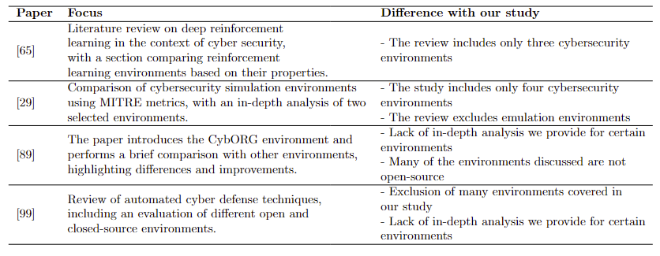
Related Works – RQ1

Slide 19
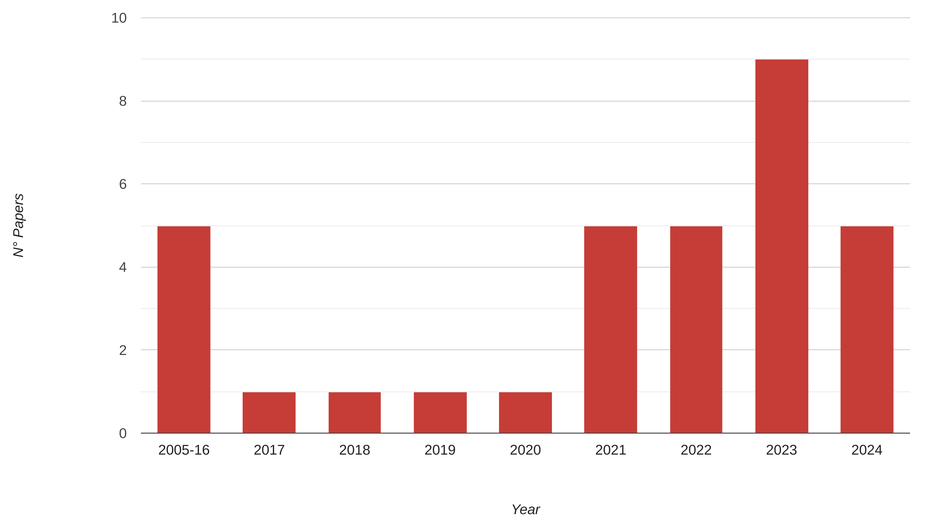
Related works – RQ2

Slide 20
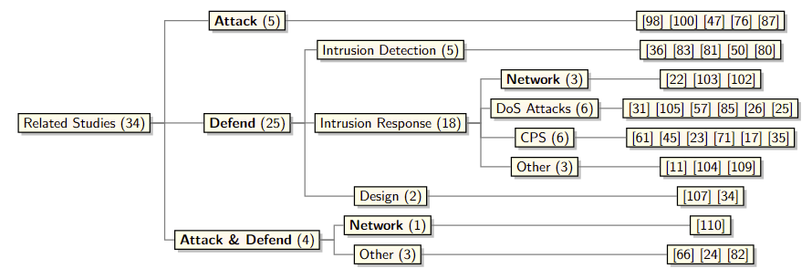
Related works – RQ2

Slide 21
Research question 1
Which open-source reinforcement learning environments for cybersecurity offer the best resources for training and deploying diverse agents?

Slide 22
Methodology – part 1
Open-source environment classified based on 4 metrics:
Last Update
Studies
Flexibility
Documentation

Slide 23
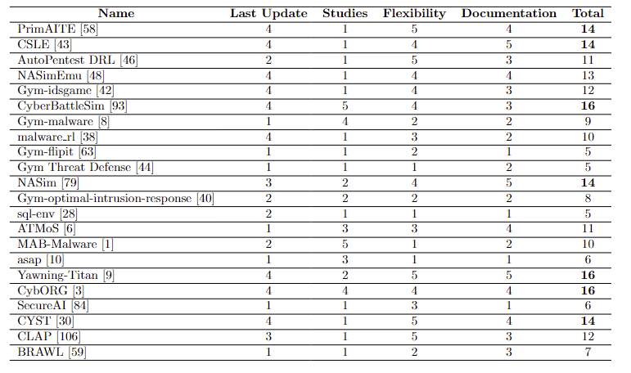
Classification 1

Slide 24
Methodology – part 2
Environments from part 1 classified based on:
Usability
Direct Multi-Agent Support
Abstraction Level
Agents Implementation
General impressions

Slide 25
Final Environment comparison - usability
CybORG | CyberBattleSim | CSLE
Great | Great | Average
Notes:
Row criteria left (table in once)

Slide 26
Final Environment comparison – MARL Support
CybORG | CyberBattleSim | CSLE
Great | Great | Average
Yes (Coop.) | No | Yes (Comp.)

Slide 27
Final Environment comparison – Abstraction level
CybORG | CyberBattleSim | CSLE
Great | Great | Average
Yes (Coop.) | No | Yes (Comp.)
Great | Average | Best

Slide 28
Final Environment comparison – Abstraction level
CybORG | CyberBattleSim | CSLE
Great | Great | Average
Yes (Coop.) | No | Yes (Comp.)
Great | Average | Best
FSM Attacker Green Agent Population | Deterministic Defender RL Attacker | RL Attacker RL Defenders

Slide 29
Final Environment comparison – Impression
CybORG | CyberBattleSim | CSLE
Great | Great | Average
Yes (Coop.) | No | Yes (Comp.)
Great | Average | Best
FSM Attacker Green Agent Population | Deterministic Defender RL Attacker | RL Attacker RL Defenders
BEST | Good | BEST

Slide 30
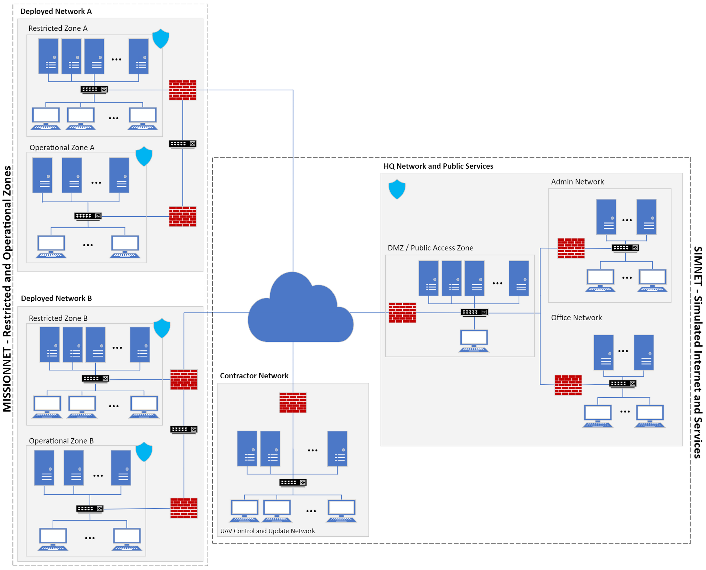
CybORG
Blue Agents Actions:
Monitor (time - 1)
Analyze (time – 2)
Decoy (time - 2): Deploys a decoy on a specified host, akin to a honeypot
Remove (time - 3): Eliminates a red agent from a targeted host.
Restore (time - 5): Returns a host to a ’clean’ state
Control Traffic (time - 1) • Messages

Slide 31
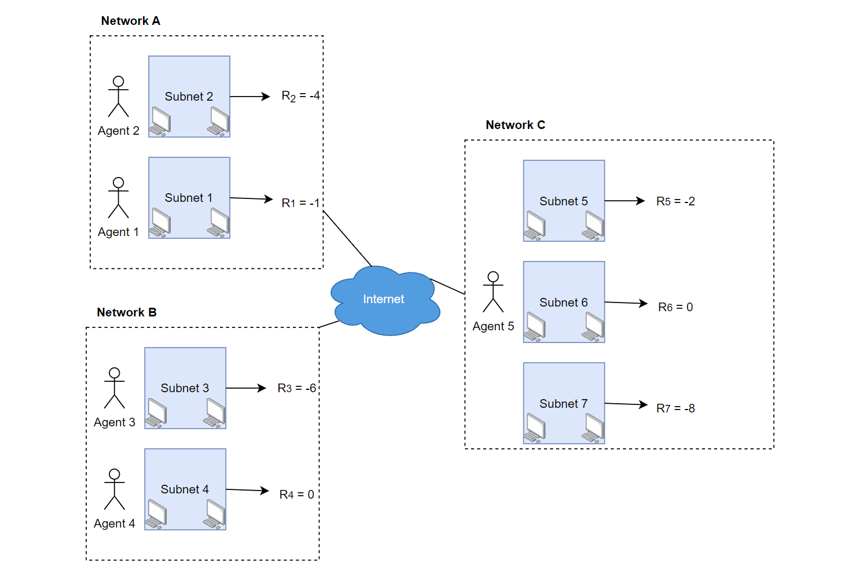
CybORG
Blue Agents Rewards:
Green Agents Determine the reward
Network availability
Quality of service
Maximum Reward = 0
3 Different Phases
Global Reward

Slide 32
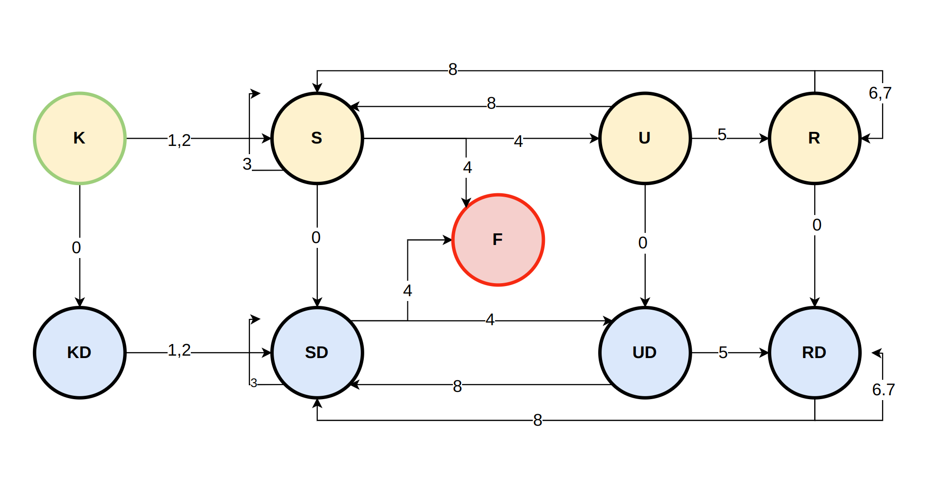
Cyborg – Red Agents
Red Agents Actions:
0 - Remote discovery (time - 1): Discover the IP address of a host in the subnet.
1 - Aggressive Discovery (time - 1): Conducts an intensive scan to uncover different hosts, high risk of detection.
2 - Stealth Discovery (time - 3): Executes a stealth scan to identify different hosts, with a lower risk of detection
3 - Deception (time - 2): Checks for the presence of honeypots deployed by blue agents
4 - Exploit Services (time - 4): Exploits services on a designated host remotely
5 - Privilege Escalation (time - 2): Performs privilege escalation on a host
6 - Impact (time - 2): Disrupts network availability between hosts
7 - Degrade Service (time - 2): Worsen the service of a green host if the attacker has root access

Slide 33
Network hosts - states
States K and KD: Indicate a host whose IP address is known to the red agent.
States S and SD: Represent a host whose services are known to the red agent.
States U and UD: Indicate a host where the red agent has an active user shell.
States R and RD: Represent a host where the red agent has an active root shell session

Slide 34
Cyborg - observations

Slide 35
Research question 2
Which reinforcement learning methods are the most effective for the chosen baseline environment?

Slide 36
Marl methods
 | IPPO | MAPPO | QMIX | MADDPG

Slide 37
Marl methods
 | IPPO | MAPPO | QMIX | MADDPG
Type of method | On-policy, Policy-based | On-policy, Policy-based | Off-policy, Value-based | Off-policy, Actor-Critic

Slide 38
Marl methods
 | IPPO | MAPPO | QMIX | MADDPG
Type of method | On-policy, Policy-based | On-policy, Policy-based | Off-policy, Value-based | Off-policy, Actor-Critic
Training | Independent | Centralized | Centralized | Centralized

Slide 39
Marl methods
 | IPPO | MAPPO | QMIX | MADDPG
Type of method | On-policy, Policy-based | On-policy, Policy-based | Off-policy, Value-based | Off-policy, Actor-Critic
Training | Independent | Centralized | Centralized | Centralized
Execution | Decentralized | Decentralized | Decentralized | Decentralized

Slide 40
Marl methods
 | IPPO | MAPPO | QMIX | MADDPG
Type of method | On-policy, Policy-based | On-policy, Policy-based | Off-policy, Value-based | Off-policy, Actor-Critic
Training | Independent | Centralized | Centralized | Centralized
Execution | Decentralized | Decentralized | Decentralized | Decentralized
Collaboration | Low | High | High | High

Slide 41
Marl methods
 | IPPO | MAPPO | QMIX | MADDPG
Type of method | On-policy, Policy-based | On-policy, Policy-based | Off-policy, Value-based | Off-policy, Actor-Critic
Training | Independent | Centralized | Centralized | Centralized
Execution | Decentralized | Decentralized | Decentralized | Decentralized
Collaboration | Low | High | High | High
Scalability | High | Low | Low | Low

Slide 42
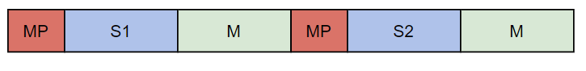
Global state representation - Concatenated

Slide 43
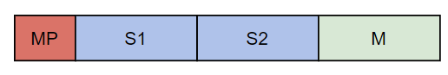
Global state representation - Compact

Slide 44
Off-policy methods - improvements
Prioritized Experience Replay
Episodes selected based on:
Novelty
Temporal-Difference (TD) error

Slide 45
Off-policy methods - improvements
Prioritized Experience Replay
Episodes selected based on:
Novelty
Temporal-Difference (TD) error
Exploration Strategy
QMIX – Epsilon-greedy
Boltzmann softmax – Probability distribution on action based on Q-values
Temperature parameter to balance exploration/exploitation

Slide 46
Individual (& hybrid) rewards
Action-Reward Attribution
Less collaboration between agents

Slide 47
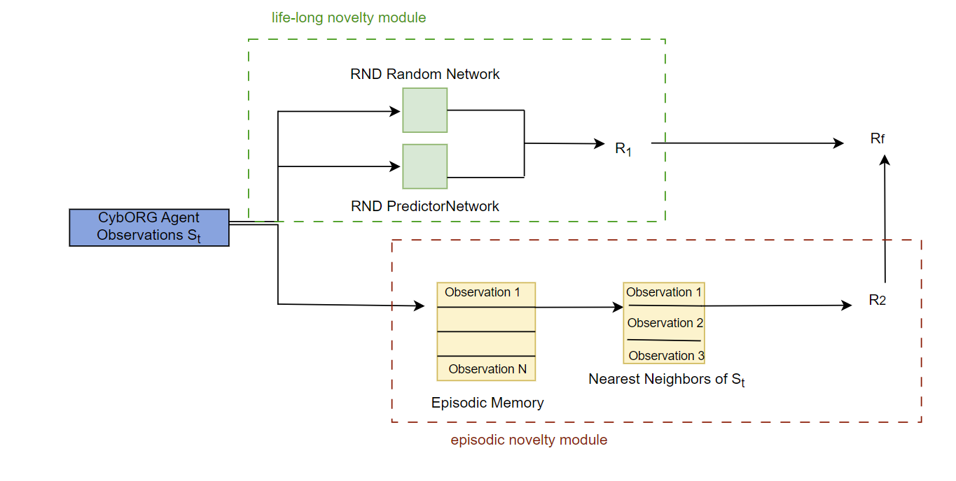
Intrinsic reward – never give up
Rewards based on exploration
Agents get an incentive to explore more than usual
Sparse Rewards settings
Normal rewards: Local minima

Slide 48
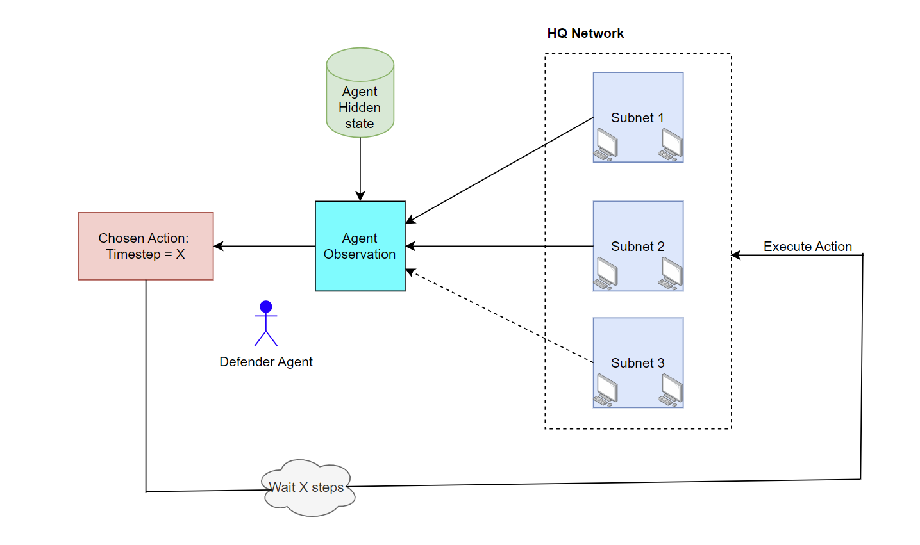
Recurrency
Partial Observability
Action effect dependency
R_QMIX (GRU)
R_IPPO/R_MAPPO (LSTM)

Slide 49
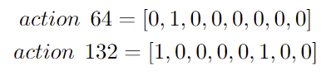
Messages
Action Messages
Encode action with 8 bits

Slide 50
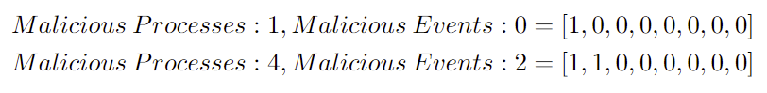
Messages
Action Messages
2 Bits messages
Encode action with 8 bits
Information on compromised Processes and Events

Slide 51
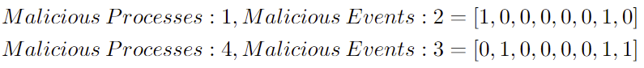
Messages
Action Messages
2 Bits messages
8 Bits messages
Encode action with 8 bits
Information on compromised Processes and Events
Information on compromised Processes and Events

Slide 52
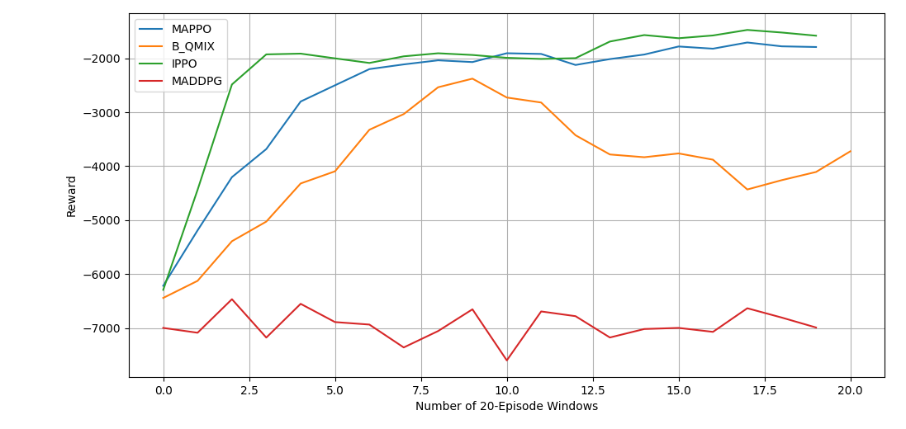
Rq2 - methods
Exploration strategy: Stochastic policy (intrinsic exploration)
Off-policy: a drawback?
Centralized vs Independent: do we need collaboration?

Slide 53
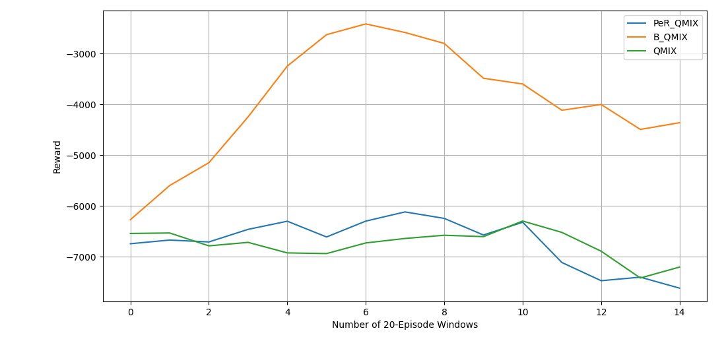
Rq2 – buffer & Exploration
PeR: Not improving results
Boltzmann Softmax: improves QMIX results
Exploration strategy

Slide 54
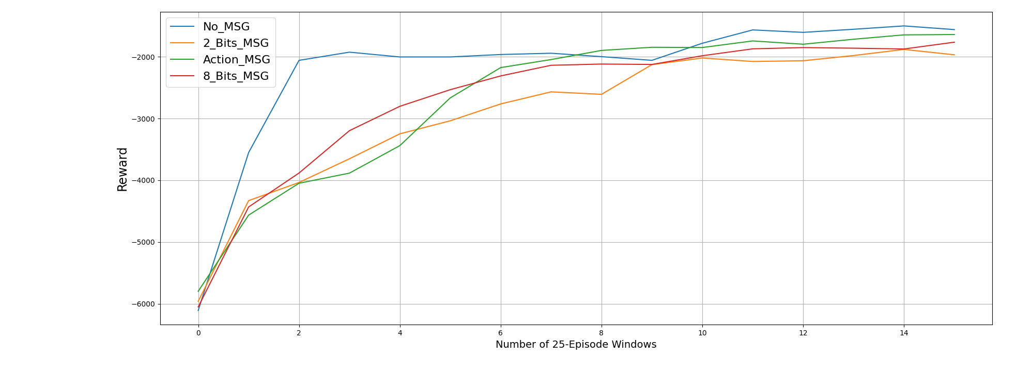
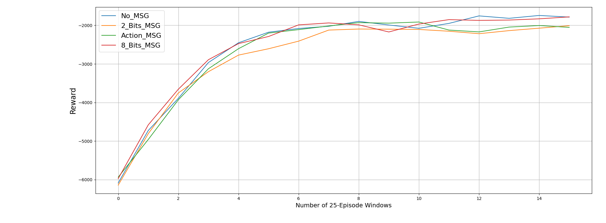
Rq2 - Messages
2 Bits: Worst message type (on average)
Are messages useful?
Do we need direct collaboration between agents?

Slide 55
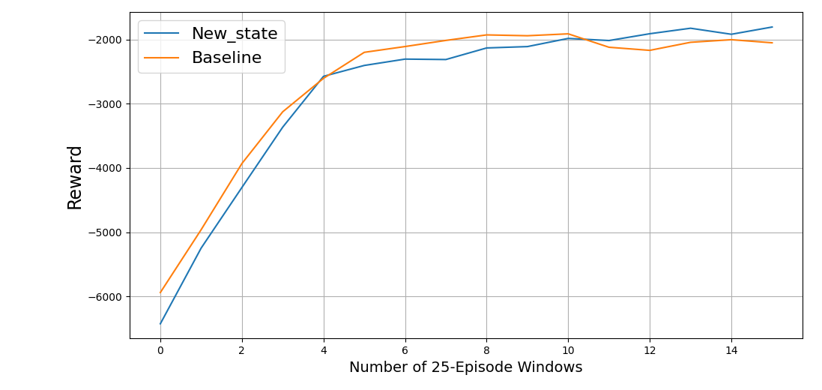
Rq2 – State representation
Compact state does not bring any improvement
Message usefulness?
Do we hit a local-maxima?

Slide 56
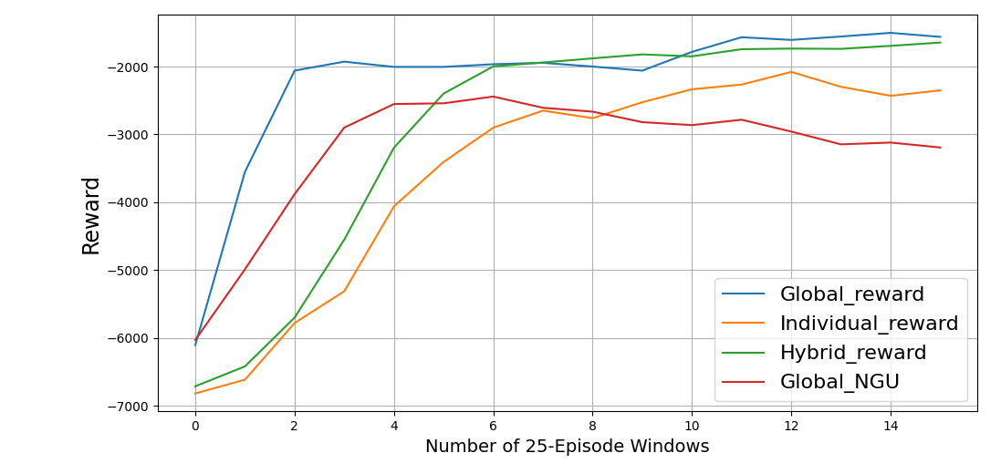
Rq2 - Rewards
NGU: no improvement to agent’s performance
Hybrid Reward: too close to the global reward?
Individual reward: not enough?
Rewards too sparse

Slide 57
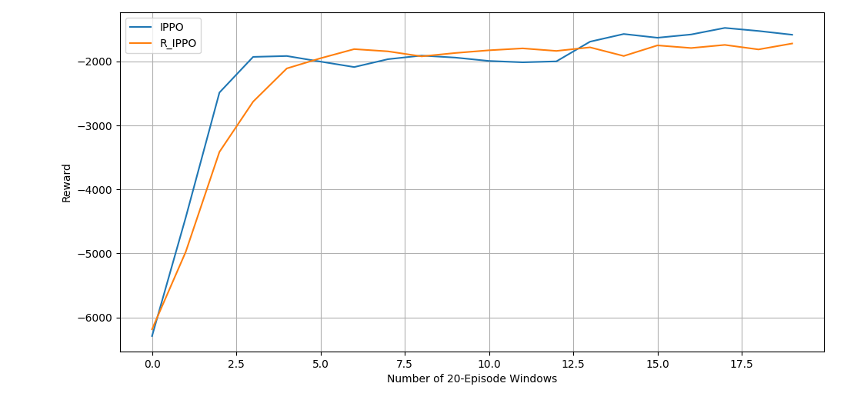
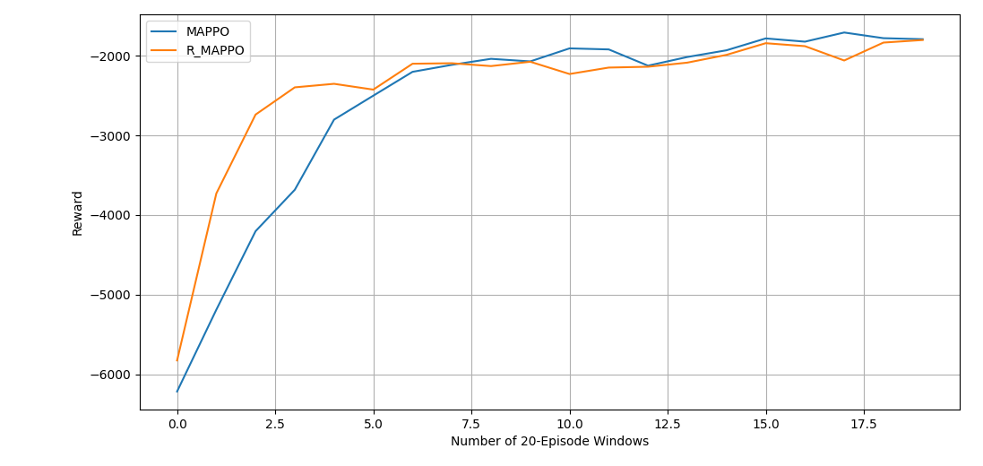
Rq2 - Recurrency
Not effective implementation?

Slide 58
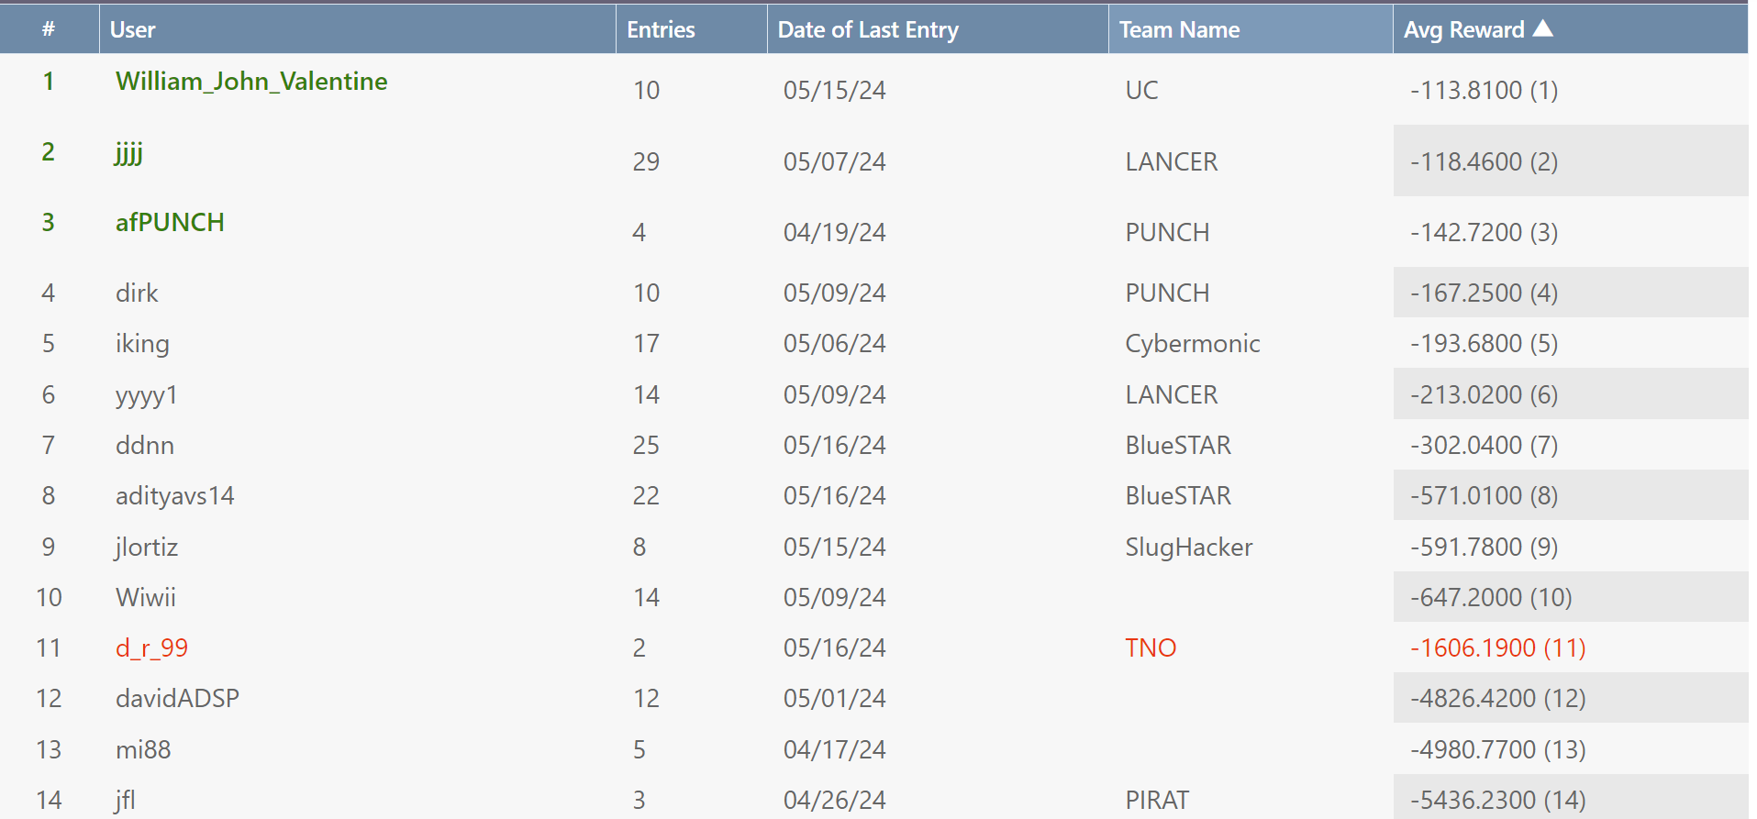
Cyborg – Challenge results

Slide 59
Research question 3
How can collaborative reinforcement learning policies be applied to defend against intrusion in the selected environment?

Slide 60
Policy analysis
Find the policy learned by the agents - Can we use it?
How does it change when changing the different aspects of the simulation?

Slide 61
Policy analysis
Find the policy learned by the agents - Can we use it?
How does it change when changing the different aspects of the simulation?

Slide 62
Environment changes
Action Timestep change

Slide 63
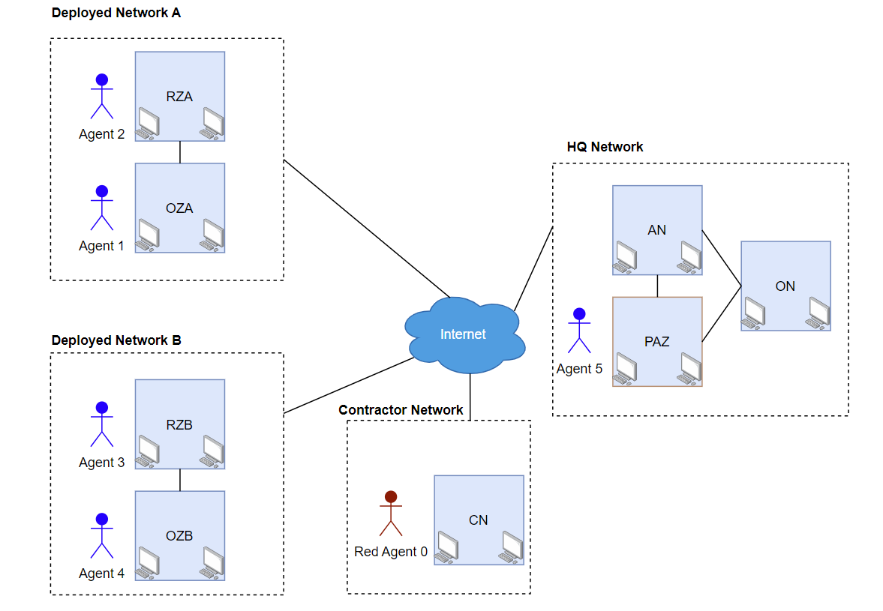
Environment changes
Action Timestep change
Agents Configuration
Baseline: 5 agents

Slide 64
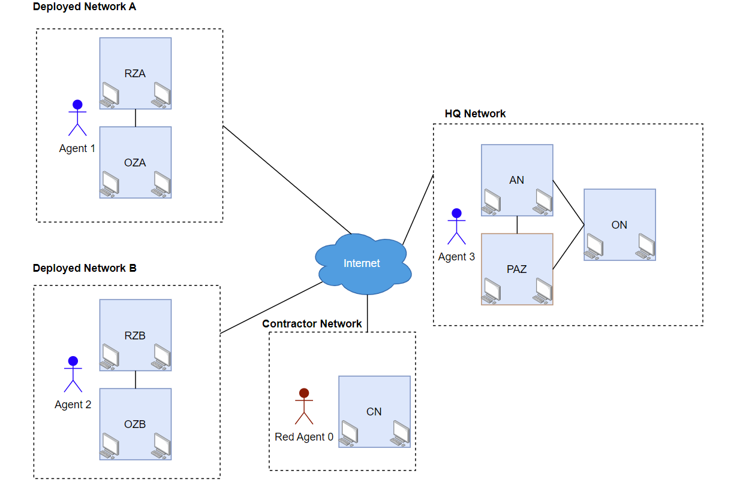
Environment changes
Action Timestep change
Agents Configuration
3 Agents

Slide 65
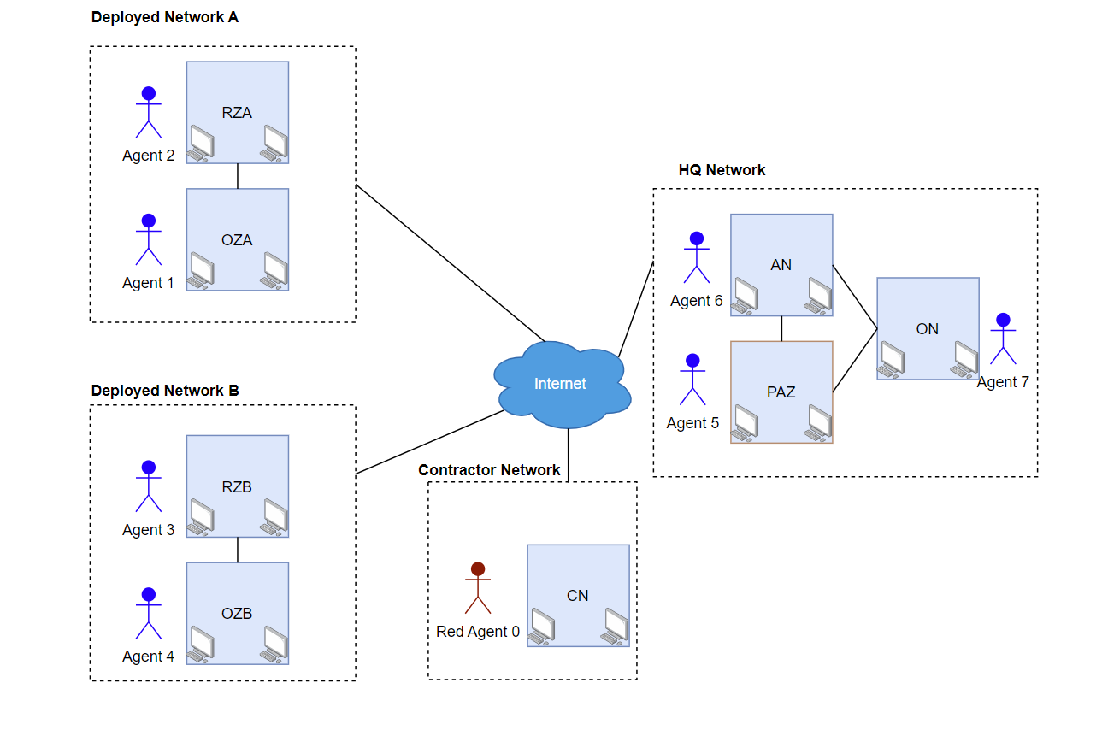
Environment changes
Action Timestep change
Agents Configuration
7 Agents

Slide 66
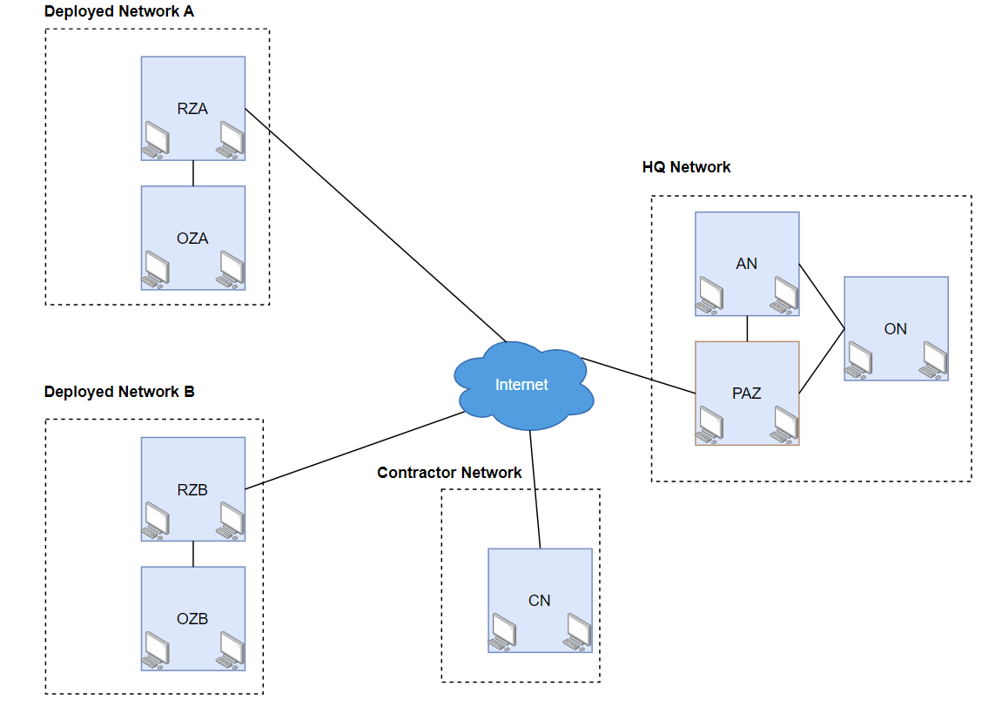
Environment changes
Action Timestep change
Agents Configuration
Network Topology
Baseline

Slide 67
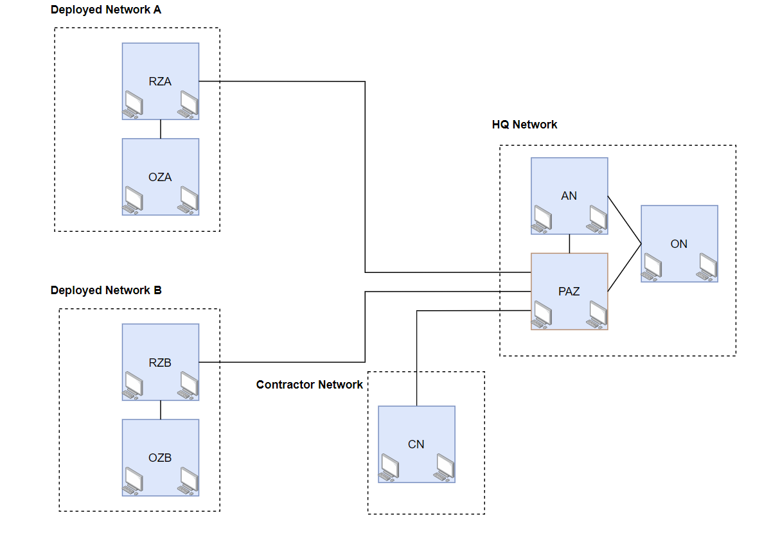
Environment changes
Action Timestep change
Agents Configuration
Network Topology
New star topology

Slide 68
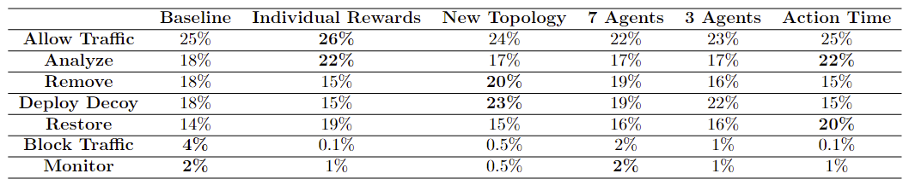
Agent policy – chosen action
Are the agent choosing the most present action types?
Restore: action timestep
Block traffic: agent organization required?
Less agent + more vulnerable subnet: Deploy Decoy?

Slide 69
Agent policy – action correlation
Correlation between blue actions and green action?
Correlation between blue actions and red action?

Slide 70
Agent policy – action correlation
Correlation between blue actions and green action?
No correlation
Correlation between blue actions and red action?
Some correlation
Hard to compute due to the partial observability
New reward and Action Timesteps bring the biggest change in policy
Not extremely significant

Slide 71
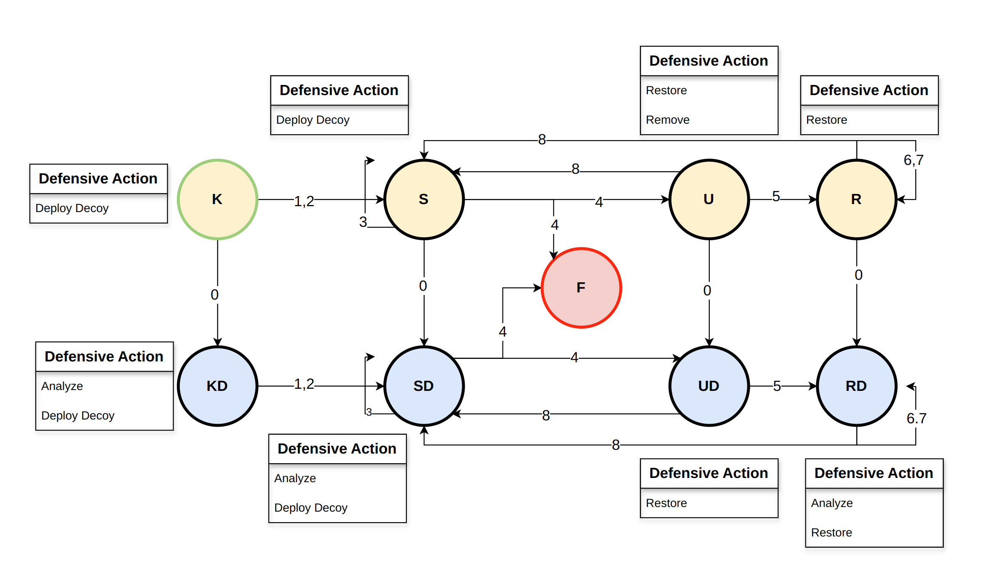
Agents policy – network hosts
Individual rewards: more definitive action choice
Positive trend: take more drastic actions for dangerous states

Slide 72
Agent policy – what does not work
Allow Traffic Zone
Most used when no malicious activity is detected
Used too aften
Upon red agent discovery not always the most optimal choice of action
Deploy Decoy is preferred over Remove at times too often
Sometimes long actions used in close succession (e.g. Remove and Restore )
This leads to a big reward penalty and an unnecessary action
Duplicate actions taken in close succession – Time depencency?

Slide 73
Conclusion

Slide 74
Collaborative rl in cybersecurity
Which environment is best?

Slide 75
Collaborative rl in cybersecurity
Which environment is best?
CybORG and CSLE

Slide 76
Collaborative rl in cybersecurity
Which environment is best?
Which method is best?

Slide 77
Collaborative rl in cybersecurity
Which environment is best?
Which method is best?
Depends on the use case
For CybORG, independent learning and policy-based methods outperform the rest

Slide 78
Collaborative rl in cybersecurity
Which environment is best?
Which method is best?
Can we use the learned policy?
Some interesting guidelines, but no usable policy
Better results can yield a better policy
Hard to fully derive a policy from the agents

Slide 79

Questions?
This Photo by Unknown Author is licensed under CC BY-SA

